Slide 1





Team: Study King
Topic: Combatting computer game addiction
Strength：
Critical Thinking
Communication Skills
Design Thinking Skills
Innovative Thinking
Analytical and Evaluation Skills
Technical Expertise
Python
Java
HTML,CSS,Java Script
UI Design
Jing Zhang
JunChong Zhang
Kenny Huang
Yuchen Hou

Slide 2


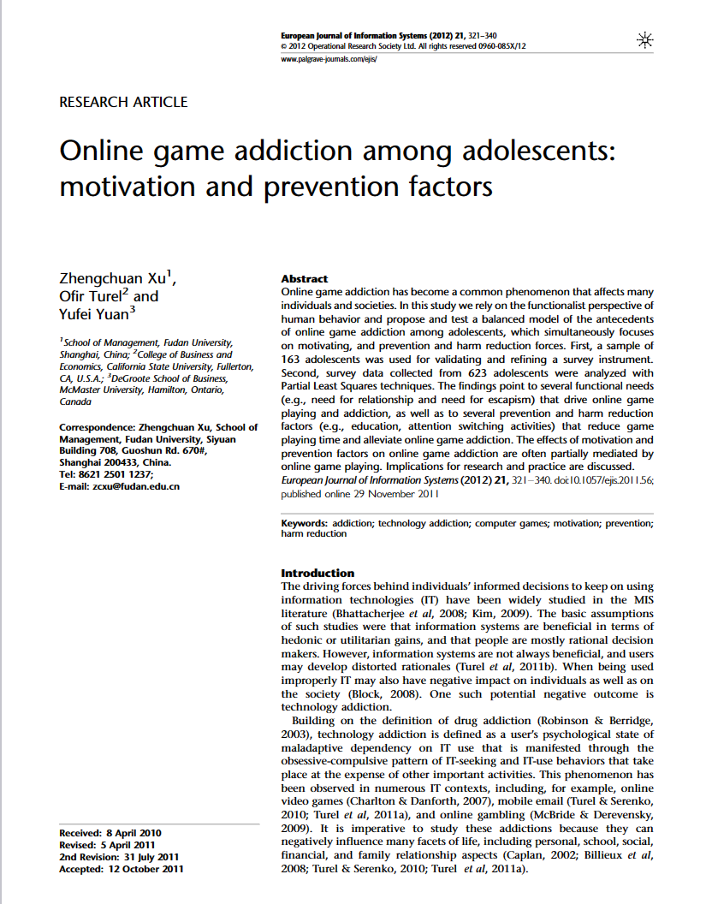

Domain & Problem Space
Problem Space:
Over-gaming
Routine Disruption
Health Neglect
Challenge:
Time Management
Risk Education
Balanced Lifestyle
Computer game addiction refers to the excessive and compulsive use of computer games, negatively impacting an individual's daily life. (Xu, Turel, & Yuan, 2012)
Definition of Computer Game Addiction
Game Design Elements
Personal Factors
Competitive Nature
Causes of Addiction
Physical Health
Mental Health
Social Consequences
Impacts of Addiction
Study King

Slide 3






Design Opportunity, Audience
Teenage Gamers
Social Concept: Activity Traces
Data Collection and Analysis
Feedback and Alerts
Parental Monitoring
Parents and Guardians
Social Concept: Collaboration
Platform Partnerships
Unified Playtime Tracker
Mobile Concept: Location-aware
Geo-Fencing for Gaming Hotspots
Activity Suggestions Based on Location
Educational Professional
Study King
Notes:
Game Time Tracking: The app can track the amount of time users spend on various games and generate easy-to-understand charts.
Feedback and Alerts
Real-Time Alerts: When a user reaches a pre-set gaming time limit, the app can send out a notification.
Parental Monitoring and Involvement
Parental Control Dashboard: Parents can view their child's activity tracking data and set gaming time limits.
2. Social Concept: Collaboration
Platform Partnerships: Collaborate with major gaming platforms to integrate time management tools directly into their systems. This would ensure a wider reach and more effective implementation.
Unified Playtime Tracker: Work with multiple game developers to create a unified system that tracks total playtime across different games and platforms.
1. Geo-Fencing for Gaming Hotspots
The app could use geo-fencing technology to identify areas where gaming is commonly done, such as internet cafes or certain recreational areas. When a user enters these zones, the app could send a notification or even lock certain gaming apps to discourage gaming in those locations.
2. Activity Suggestions Based on Location
The app could suggest alternative activities based on the user's current location. For example, if the user is near a park, the app could suggest going for a walk or playing a sport. This feature could help divert attention away from gaming and encourage more physical activity.

Slide 4


Concepts & Previous attempts
Behavioral Interventions:
Parental Monitoring:
Resource Restrictions
Dissuasion
Educational Interventions:
Rationalization/Education
Economic Interventions:
Perceived Cost
Psychological and Social Interventions:
Impulsivity in game use
Internet addiction & game loyalty
Parental warmth & gaming habits.
Technological Interventions:
Brain activity & gaming urge
Qustodio is a parental monitoring app that helps parents control their children's internet activity. It not only limits the time spent online, but also controls the use of games and apps.
(Xu, Turel, & Yuan, 2012)
Forest is a time management app that helps you focus on work and study by planting virtual trees.
Study King
Xu, Z., Turel, O., & Yuan, Y. (2012). Online game addiction among adolescents: motivation and prevention factors. European journal of information systems, 21(3), 321-340
Notes:
Behavioral Interventions:
Parental Monitoring: Parents play a crucial role in monitoring their children's online game playing habits. This includes knowing where their children are after school, whom they are with, and even controlling their game playing time.
Resource Restrictions: Limiting resources such as pocket money, computer access, and network speed can deter excessive gaming.
Dissuasion: Teachers and parents can intervene early, constantly remind, dissuade, and warn against excessive online game playing.
Educational Interventions:
Rationalization/Education: Education by teachers and parents helps adolescents realize the consequences of excessively playing online games. This can be supplemented by educational movies, media reports on online game addiction, and learning from symptoms suffered by peers due to excessive gaming.
Economic Interventions:
Perceived Cost: The high costs associated with online gaming, such as equipment costs, per-hour playing costs, internet access fees, and associated costs like snacks, can act as deterrents. However, it's noted that some may perceive these fees as reasonable.
Psychological and Social Interventions:
Studies have explored the role of impulsivity in actual and problematic use of online games.
The role of internet addiction in online game loyalty has been investigated.
The influence of parental warmth and control on adolescent behavior, including online gaming habits, has been studied.
Technological Interventions:
Brain activity & gaming urge
Concept：Qustodio is a parental monitoring app designed to help parents control their children's activities on the Internet. In addition to limiting and monitoring Internet time, Qustodio offers control options for games and apps. Parents can set timers to limit gaming time and can track their children's gaming and internet habits. In addition, Qustodio offers real-time reports and alerts to keep parents informed of their children's online activities and to intervene in a timely manner.
Forest is an app focused on time management and improving concentration that can be used to limit cell phone usage time, including game time. What makes this app unique is that it associates limiting cell phone usage time with the planting of a virtual tree. When you start focusing on work or study, you can plant a virtual tree and then let the tree grow for a set period of time. If you don't use your cell phone within the time limit, the tree will grow and flourish, and vice versa.

Slide 5
Plan of work & methods
Interview&Research
Prototype
Users evaluation
Do user interviews，research papers and other materials related .
Do user interviews to understand the
needs, behavior patterns, and preferences of target users. By combining these , we can integrate our ideas and form a design direction.
In the process of the transformation of low-fidelity prototype to high-fidelity, we will conduct user observation and simple testing. This will help us understand how users behave and react when using the interface
We will then conduct a formal user evaluation and feedback gathering. Providing the high-fidelity prototype to users for testing and evaluation helps us further understand the user experience and the usability of the interface. We will collect users' comments, suggestions and opinions so that we can make improvements based on their expectation
Study King

